Slide 1
Fundamentals of Hypothesis Testing: One-Sample Tests

Slide 2
Objectives
In this lecturer, you learn:
The basic principles of hypothesis testing
How to use hypothesis testing to test a mean or proportion

Slide 3
Introduction
The purpose of hypothesis testing is to determine whether there is enough statistical evidence in favor of a certain belief about a parameter.
A hypothesis is a preliminary or tentative explanation or postulate by the researcher of what the researcher considers the outcome of an investigation will be. It is an informed/educated guess.
It indicates the expectations of the researcher regarding certain variables. It is the most specific way in which an answer to a problem can be stated.

Slide 4
What is hypothesis
A tentative statement about a population parameter that might be true or wrong
4

Slide 5
THE DIFFERENCE BETWEEN AN HYPOTHESIS AND A PROBLEM
Both a hypothesis and a problem contribute to the body of knowledge that supports or refutes an existing theory.
A hypothesis differs from a problem.
A problem is formulated in the form of a question; it serves as the basis or origin from which a hypothesis is derived.
A hypothesis is a suggested solution to a problem.
A problem (question) cannot be directly tested, whereas a hypothesis can be tested and verified.
5

Slide 6
What is a Hypothesis?
A hypothesis is a claim
(assertion) about a
population parameter:
population mean
population proportion
Example: The mean monthly cell phone bill in this city is μ = $42
Example: The proportion of adults in this city with cell phones is π = 0.68

Slide 7

The Null Hypothesis, H₀
States the claim or assertion to be tested
Example: The mean diameter of a manufactured bolt is 30mm ( )
Is always about a population parameter, not about a sample statistic

Slide 8
The Null Hypothesis, H₀
(continued)
Begin with the assumption that the null hypothesis is true x
Similar to the notion of innocent until proven guilty
Always contains “=“, or “≤”, or “≥” sign
May or may not be rejected

Slide 9
The Alternative Hypothesis, H₁
Is the opposite of the null hypothesis
e.g., The mean diameter of a manufactured bolt is not equal to 30mm ( H₁: μ ≠ 30 )
Never contains the “=“, or “≤”, or “≥” sign
May or may not be proven
Is generally the hypothesis that the researcher is trying to prove

Slide 10
The Hypothesis Testing Process
Claim: The population mean age is 50.
H₀: μ = 50, H₁: μ ≠ 50
Sample the population and find the sample mean.
Population
Sample

Slide 11
The Hypothesis Testing Process
(continued)
Suppose the sample mean age was X = 20.
This is significantly lower than the claimed mean population age of 50.
If the null hypothesis were true, the probability of getting such a different sample mean would be very small, so you reject the null hypothesis.
In other words, getting a sample mean of 20 is so unlikely if the population mean was 50, you conclude that the population mean must not be 50.

Slide 12
The Hypothesis Testing Process
(continued)
Sampling Distribution of X
X
20
μ = 50
If H₀ is true
... then you reject the null hypothesis that μ = 50.
If it is unlikely that you would get a sample mean of this value ...
... When in fact this were the population mean…

Slide 13
The Test Statistic and Critical Values
If the sample mean is close to the stated population mean, the null hypothesis is not rejected.
If the sample mean is far from the stated population mean, the null hypothesis is rejected.
How far is “far enough” to reject H₀?
The critical value of a test statistic creates a “line in the sand” for decision making -- it answers the question of how far is far enough.

Slide 14
The Test Statistic and Critical Values
Sampling Distribution of the test statistic
Region of Rejection
Region of Rejection
Region of
Non-Rejection
Critical Values
“Too Far Away” From Mean of Sampling Distribution

Slide 15
Risks in Decision Making Using Hypothesis Testing
Type I Error
Reject a true null hypothesis
A type I error is a “false alarm”
The probability of a Type I Error is α
Called level of significance of the test
Set by researcher in advance
Type II Error
Failure to reject a false null hypothesis
Type II error represents a “missed opportunity”
The probability of a Type II Error is β

Slide 16
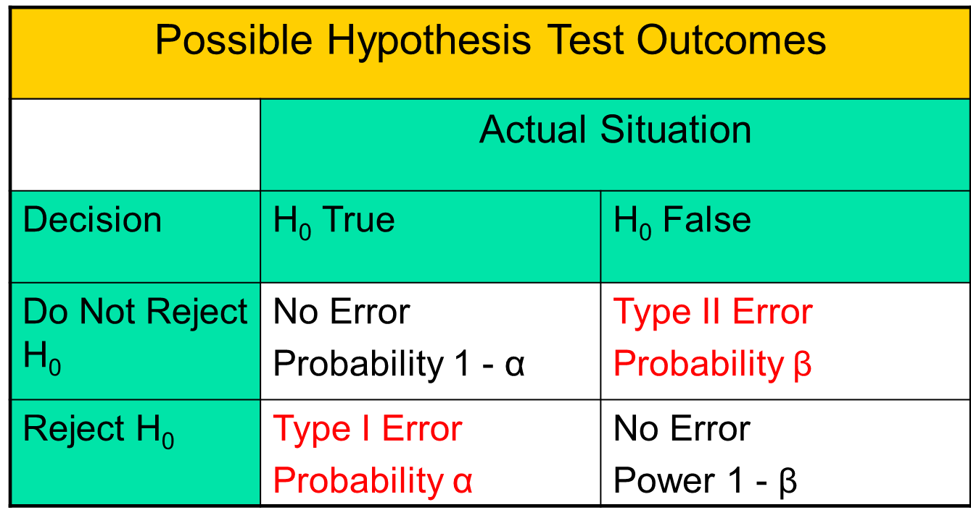
Possible Errors in Hypothesis Test Decision Making
(continued)

Slide 17
Possible Errors in Hypothesis Test Decision Making
(continued)
The confidence coefficient (1-α) is the probability of not rejecting H₀ when it is true.
The confidence level of a hypothesis test is (1-α)*100%.
The power of a statistical test (1-β) is the probability of rejecting H₀ when it is false.

Slide 18
Level of Significance and the Rejection Region
H₀: μ = 30 H₁: μ ≠ 30
Level of significance =
α
α
α
/2
/2
30
Critical values
Rejection Region
This is a two-tail test because there is a rejection region in both tails

Slide 19
Hypothesis Tests for the Mean
Hypothesis
Tests for μ
σ Known
σ Unknown
(Z test)
(t test)

Slide 20
Z Test of Hypothesis for the Mean (σ Known)
Convert sample statistic ( ) to a Z_{STAT} test statistic
X
Hypothesis
Tests for μ
σ Known
σ Known
σ Unknown
σ Unknown
(Z test)
(t test)
The test statistic is:

Slide 21
Critical Value Approach to Testing
DCOVA
For a two-tail test for the mean, σ known:
Convert sample statistic ( ) to test statistic (Z_{STAT})
Determine the critical Z values for a specified level of significance α from a table or by using computer software
Decision Rule: If the test statistic falls in the rejection region, reject H₀ ; otherwise do not reject H₀
X

Slide 22
Two-Tail Tests
DCOVA
H₀: μ = 30 H₁: μ ≠ 30
There are two cutoff values (critical values), defining the regions of rejection
α/2
α/2
X
30
Reject H₀
Do not reject H₀
Reject H₀
-Z_{α/2}
+Z_{α/2}
Z
0
Lower critical value
Upper critical value

Slide 23
6 Steps in Hypothesis Testing
DCOVA
State the null hypothesis, H₀ and the alternative hypothesis, H₁
Choose the level of significance, α, and the sample size, n.
Determine the appropriate test statistic and sampling distribution
Determine the critical values that divide the rejection and nonrejection regions

Slide 24
6 Steps in Hypothesis Testing
(continued)
DCOVA
Collect data and compute the value of the test statistic
Make the statistical decision and state the managerial conclusion. If the test statistic falls into the nonrejection region, do not reject the null hypothesis H₀. If the test statistic falls into the rejection region, reject the null hypothesis. Express the managerial conclusion in the context of the problem

Slide 25
Hypothesis Testing Example
DCOVA
Test the claim that the true mean diameter of a manufactured bolt is 30mm.
(Assume σ = 0.8)
1. State the appropriate null and alternative
hypotheses
H₀: μ = 30 H₁: μ ≠ 30 (This is a two-tail test)
2. Specify the desired level of significance and the sample size
Suppose that α = 0.05 and n = 100 are chosen for this test

Slide 26
Hypothesis Testing Example
(continued)
3. Determine the appropriate technique
σ is assumed known so this is a Z test
4. Determine the critical values
For α = 0.05 the critical Z values are ±1.96
5. Collect the data and compute the test statistic
Suppose the sample results are
n = 100, X = 29.84 (σ = 0.8 is assumed known)
So the test statistic is:

Slide 27
Hypothesis Testing Example
(continued)
6. Is the test statistic in the rejection region?
α/2 = 0.025
α/2 = 0.025
Reject H₀ if Z_{STAT} < -1.96 or Z_{STAT} > 1.96; otherwise do not reject H₀
Reject H₀
Do not reject H₀
Reject H₀
-Z_{α/2} = -1.96
0
+Z_{α/2} = +1.96
Here, Z_{STAT} = -2.0 < -1.96, so the test statistic is in the rejection region

Slide 28
Hypothesis Testing Example
(continued)
DCOVA
6 (continued). Reach a decision and interpret the result
α = 0.05/2
α = 0.05/2
Reject H₀
Do not reject H₀
Reject H₀
-Z_{α/2} = -1.96
0
+Z_{α/2}= +1.96
-2.0
Since Z_{STAT} = -2.0 < -1.96, reject the null hypothesis and conclude there is sufficient evidence that the mean diameter of a manufactured bolt is not equal to 30

Slide 29
p-Value Approach to Testing
p-value: Probability of obtaining a test statistic equal to or more extreme than the observed sample value given H₀ is true
The p-value is also called the observed level of significance
It is the smallest value of α for which H₀ can be rejected

Slide 30
p-Value Approach to Testing: Interpreting the p-value
DCOVA
Compare the p-value with α
If p-value < α , reject H₀
If p-value ≥ α , do not reject H₀
Remember
If the p-value is low then H₀ must go

Slide 31
The 5 Step p-value approach to Hypothesis Testing
DCOVA
State the null hypothesis, H₀ and the alternative hypothesis, H₁
Choose the level of significance, α, and the sample size, n. The level of significance is based on the relative importance of the risks of a type I and a type II error.
Determine the appropriate test statistic and sampling distribution
Collect data and compute the value of the test statistic and the p-value
Make the statistical decision and state the managerial conclusion. If the p-value is < α then reject H₀, otherwise do not reject H₀. State the managerial conclusion in the context of the problem

Slide 32
p-value Hypothesis Testing Example
DCOVA
Test the claim that the true mean diameter of a manufactured bolt is 30mm.
(Assume σ = 0.8)
1. State the appropriate null and alternative
hypotheses
H₀: μ = 30 H₁: μ ≠ 30 (This is a two-tail test)
2. Specify the desired level of significance and the sample size
Suppose that α = 0.05 and n = 100 are chosen for this test

Slide 33
p-value Hypothesis Testing Example
(continued)
DCOVA
3. Determine the appropriate technique
σ is assumed known so this is a Z test.
4. Collect the data, compute the test statistic and the p-value
Suppose the sample results are
n = 100, X = 29.84 (σ = 0.8 is assumed known)
So the test statistic is:

Slide 34
p-Value Hypothesis Testing Example: Calculating the p-value
(continued)
DCOVA
4. (continued) Calculate the p-value.
How likely is it to get a Z_{STAT} of -2 (or something further from the mean (0), in either direction) if H₀ is true?
P(Z < -2.0) = 0.0228
P(Z > 2.0) = 0.0228
0
Z
-2.0
2.0
p-value = 0.0228 + 0.0228 = 0.0456

Slide 35
p-value Hypothesis Testing Example
(continued)
DCOVA
5. Is the p-value < α?
Since p-value = 0.0456 < α = 0.05 Reject H₀
5. (continued) State the managerial conclusion in the context of the situation.
There is sufficient evidence to conclude the mean diameter of a manufactured bolt is not equal to 30mm.

Slide 36
Connection Between Two Tail Tests and Confidence Intervals
DCOVA
For X = 29.84, σ = 0.8 and n = 100, the 95% confidence interval is:
29.6832 ≤ μ ≤ 29.9968
Since this interval does not contain the hypothesized mean (30), we reject the null hypothesis at α = 0.05

Slide 37
Do You Ever Truly Know σ?
DCOVA
Probably not!
In virtually all real world business situations, σ is not known.
If there is a situation where σ is known then µ is also known (since to calculate σ you need to know µ.)
If you truly know µ there would be no need to gather a sample to estimate it.

Slide 38
Hypothesis Testing: σ Unknown
If the population standard deviation is unknown, you instead use the sample standard deviation S.
Because of this change, you use the t distribution instead of the Z distribution to test the null hypothesis about the mean.
When using the t distribution you must assume the population you are sampling from follows a normal distribution.
All other steps, concepts, and conclusions are the same.

Slide 39
t Test of Hypothesis for the Mean (σ Unknown)
DCOVA
Convert sample statistic ( ) to a t_{STAT} test statistic
X
Hypothesis
Tests for μ
Hypothesis
Tests for μ
Hypothesis
Tests for μ
σ Known
σ Known
σ Known
σ Known
σ Known
σ Known
σ Unknown
σ Unknown
σ Unknown
σ Unknown
σ Unknown
σ Unknown
(Z test)
(Z test)
(Z test)
(t test)
(t test)
(t test)
The test statistic is:
The test statistic is:
The test statistic is:

Slide 40
Example: Two-Tail Test (σ Unknown)
The average cost of a hotel room in New York is said to be $168 per night. To determine if this is true, a random sample of 25 hotels is taken and resulted in an X of $172.50 and an S of $15.40. Test the appropriate hypotheses at α = 0.05.
(Assume the population distribution is normal)
H₀: μ = 168 H₁: μ ≠ 168

Slide 41
Example Solution: Two-Tail t Test
H₀: μ = 168 H₁: μ ≠ 168
α/2=.025
α/2=.025
α = 0.05
n = 25, df = 25-1=24
σ is unknown, so
use a t statistic
Critical Value:
±t_{24,0.025} = ± 2.0639
Reject H₀
Do not reject H₀
Reject H₀
-t _{24,0.025}
t _{24,0.025}
0
-2.0639
2.0639
1.46
Do not reject H₀: insufficient evidence that true mean cost is different from $168

Slide 42
Connection of Two Tail Tests to Confidence Intervals
For X = 172.5, S = 15.40 and n = 25, the 95% confidence interval for µ is:
172.5 - (2.0639) 15.4/ 25 to 172.5 + (2.0639) 15.4/ 25
166.14 ≤ μ ≤ 178.86
Since this interval contains the Hypothesized mean (168), we do not reject the null hypothesis at α = 0.05

Slide 43
One-Tail Tests
In many cases, the alternative hypothesis focuses on a particular direction
This is a lower-tail test since the alternative hypothesis is focused on the lower tail below the mean of 3
H₀: μ ≥ 3
H₁: μ < 3
H₀: μ ≤ 3
H₁: μ > 3
This is an upper-tail test since the alternative hypothesis is focused on the upper tail above the mean of 3

Slide 44
Lower-Tail Tests
H₀: μ ≥ 3
H₁: μ < 3
There is only one critical value, since the rejection area is in only one tail
α
Reject H₀
Do not reject H₀
Z or t
-Z_{α} or -t_{α}
0
μ
X
Critical value

Slide 45
Upper-Tail Tests
H₀: μ ≤ 3
H₁: μ > 3
There is only one critical value, since the rejection area is in only one tail
α
Z or t
Do not reject H₀
Reject H₀
0
Z_{α} or t_{α}
_
X
μ
Critical value

Slide 46
Example: Upper-Tail t Test for Mean (σ unknown)
A phone industry manager thinks that customer monthly cell phone bills have increased, and now average over $52 per month. The company wishes to test this claim. (Assume a normal population)
Form hypothesis test:
H₀: μ ≤ 52 the mean is not over $52 per month
H₁: μ > 52 the mean is greater than $52 per month
(i.e., sufficient evidence exists to support the
manager’s claim)

Slide 47
Example: Find Rejection Region
(continued)
Suppose that α = 0.10 is chosen for this test and n = 25.
Find the rejection region:
Reject H₀
α = 0.10
Do not reject H₀
Reject H₀
0
1.318
Reject H₀ if t_{STAT} > 1.318

Slide 48
Example: Test Statistic
(continued)
Obtain sample and compute the test statistic
Suppose a sample is taken with the following results: n = 25, X = 53.1, and S = 10
Then the test statistic is:

Slide 49
Example: Decision
(continued)
Reach a decision and interpret the result:
Reject H₀
α = 0.10
Do not reject H₀
1.318
Reject H₀
0
t_{STAT} = 0.55
Do not reject H₀ since t_{STAT} = 0.55 < 1.318
there is not sufficient evidence that the
mean bill is over $52

